Slide 1


Paucek & Lage
Home
About Us
Project
Contact
Pacman
Game
PRESENTATION
Start Slide

Slide 2

Paucek & Lage
Home
About Us
Project
Contact
Project Supervision
& Team Members
Supervised by:
  Dr. Mahmoud Bassiuoni
Project Team Members
  Mahmoud Ashry
  Sohaila Abdelnasser
  Fatma El Zahraa Mohamed
Teaching Assistants:
  Eng. Mohamed Gaber
  Eng. Basma Bassem
  Jumana Hazem
  Omar mohamed
  Hana Mohammed
Next Slide

Slide 3
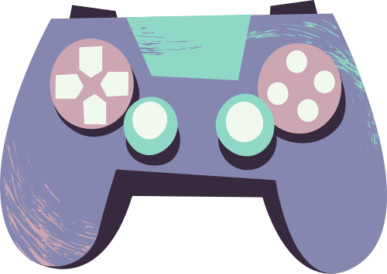

Paucek & Lage
Home
About Us
Project
Contact
This project presents a Pacman-inspired game that demonstrates the application of Artificial Intelligence search algorithms in a game environment.
The game follows a Human vs AI model, where the human player controls Pacman, while the opponent (the ghost) is controlled by an intelligent agent.
The main objective of the game is for the human player to navigate Pacman through a maze, collect all available food pellets, and avoid being caught by the AI-controlled ghost.
The game ends when either:
Pacman collects all food pellets (win condition), or
The ghost catches Pacman (lose condition).
Project
Description
Next Slide

Slide 4
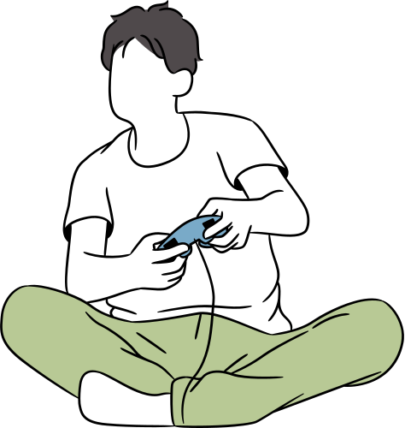
Paucek & Lage
Home
About Us
Project
Contact
Artificial Intelligence
& Component
  The ghost in the game is implemented as an AI agent that uses the A* (A-star) search algorithm to chase Pacman efficiently inside the maze.
  Each cell in the maze represents a state.
  Possible actions include moving up, down, left, or right.
  The goal state for the AI is reaching Pacman’s current position.
  The Manhattan distance heuristic is used to estimate the cost from the ghost’s position to Pacman.
  The A* algorithm guarantees finding an optimal or near-optimal path, making the ghost’s behavior intelligent and challenging, especially at higher difficulty levels.
Next Slide

Slide 5
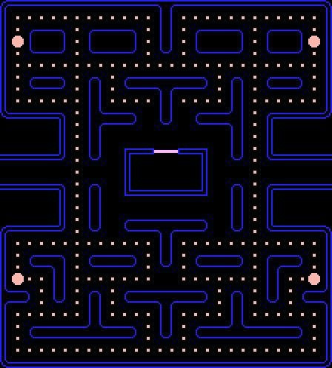
Paucek & Lage
Home
About Us
Project
Contact
🎮 Difficulty
Levels
The project is designed using a modular architecture:
One module handles the game logic and AI decision-making.
A separate module manages the graphical user interface (GUI) using Pygame.
This separation improves readability, maintainability, and scalability of the code.
Next Slide

Slide 6

Paucek & Lage
Home
About Us
Project
Contact
System
Design
The project is designed using a modular architecture:
One module handles the game logic and AI decision-making.
A separate module manages the graphical user interface (GUI) using Pygame.
This separation improves readability, maintainability, and scalability of the code.
Next Slide

Slide 7
Paucek & Lage
Home
About Us
Project
Contact
Thank
You!
End Slide

